Slide 1
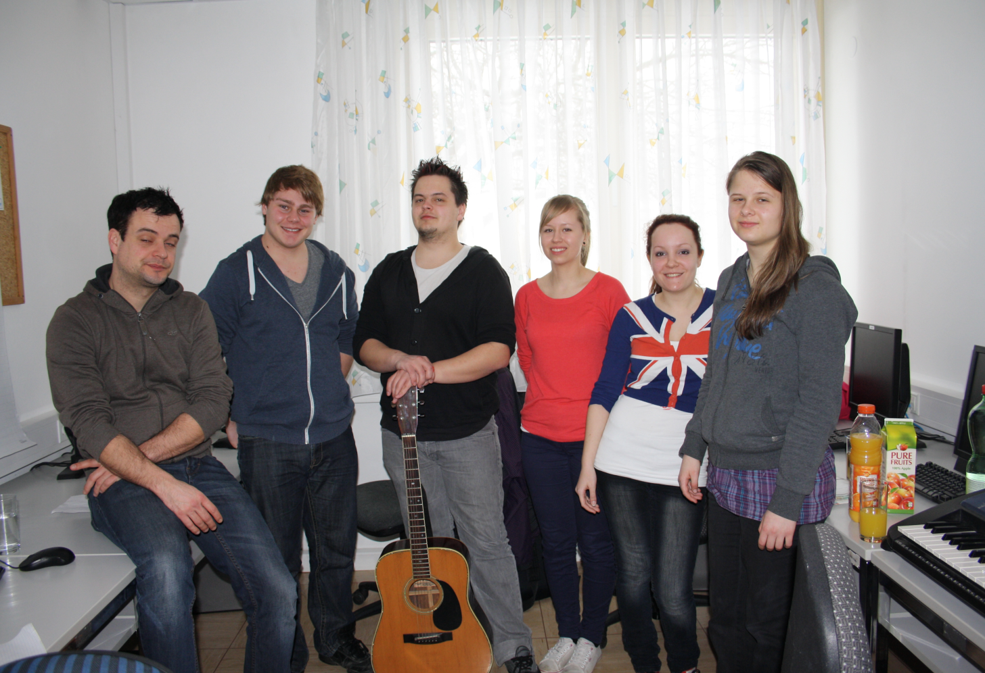
Introducing:
The most awesome Writing-Group of all time!
Elisabeth
Gregory
Stefan
Elias
Pinja
Sonja

Slide 2
So welcome in my Heart
Her body, mind, and spirit – Sweet-scented like a rose, So cherished in my heart, is she; No thorny night’s repose. I truly fell, the day we met, Love’s visions, gifts ignored – Her beauty, grace, and loveliness, Are memories still stored. May we embrace this union Of souls, both hers and mine? So welcome in my heart, is she, Like sweet, red-cherry wine. Such success and joy in life, I feel so truly blessed, To call her my companion, And never be too stressed. Tomorrow paints the canvas, And a love so bright, secured – Our golden lives together, Like wings, have still endured.

Slide 3
Love, just like life, Is not always like a dream Sometimes reality’s too strong, Too sad - and things go wrong.
Thank you for your attention!

